Slide 1
Testbed for Validating Second-Generation TDI and Clock Noise Correction for LISA
Karin Kruuse
Notes:
Date. Change
Add event, location, student seminar intro talk

Slide 2
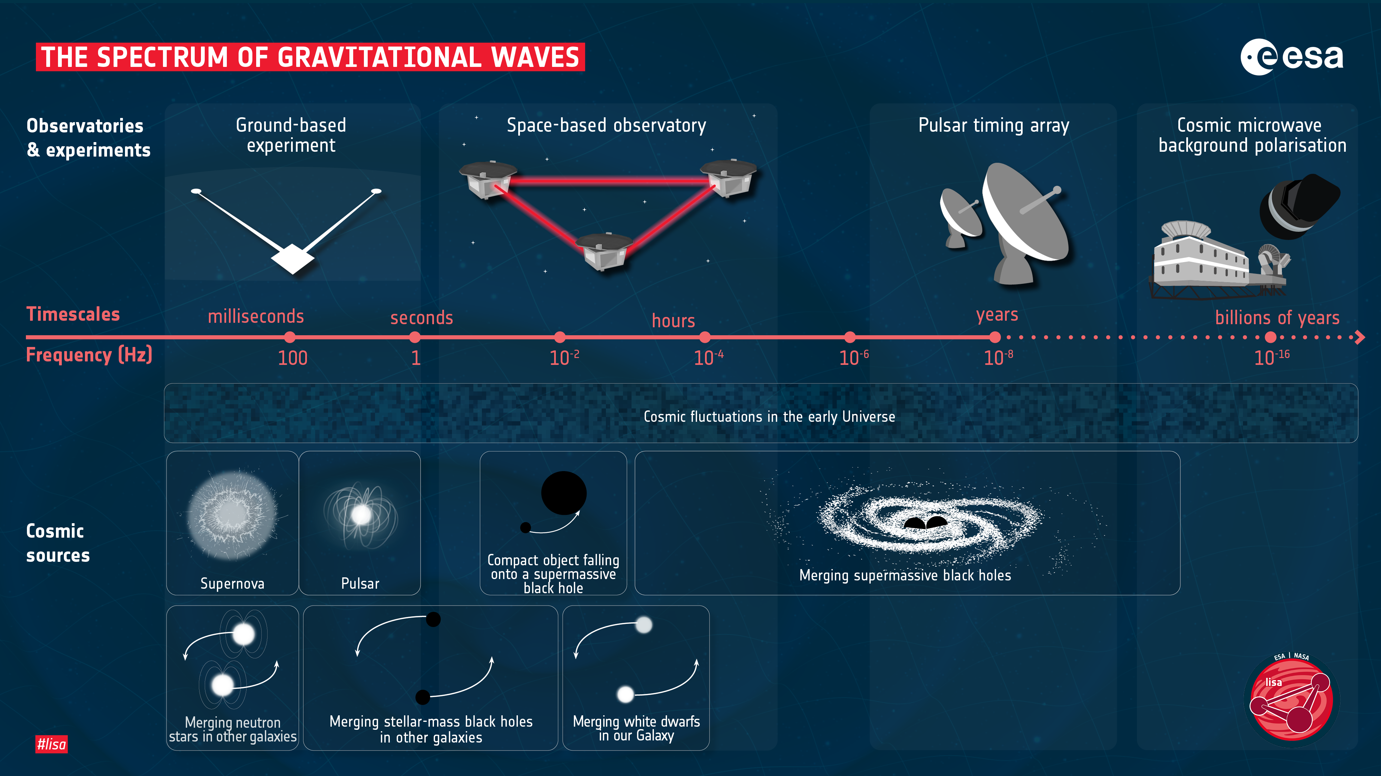

Slide 3
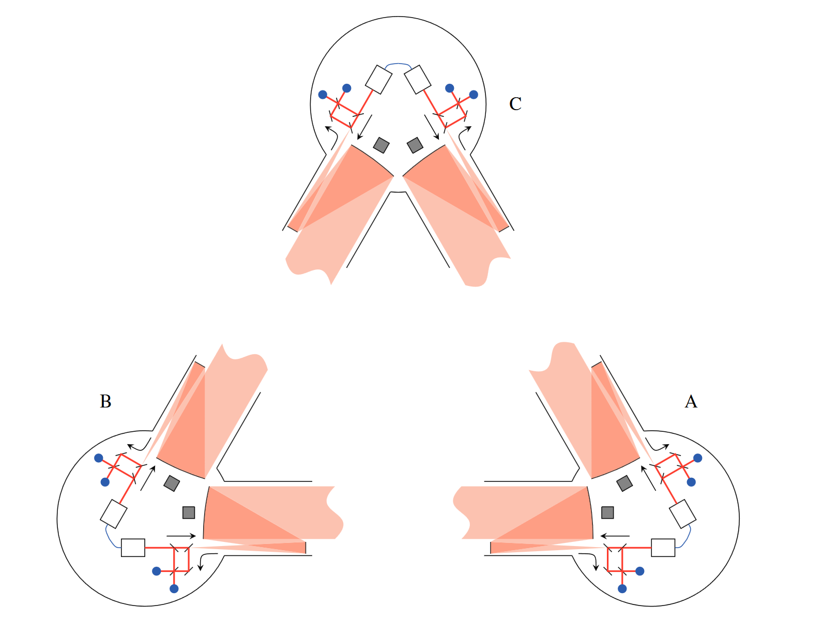
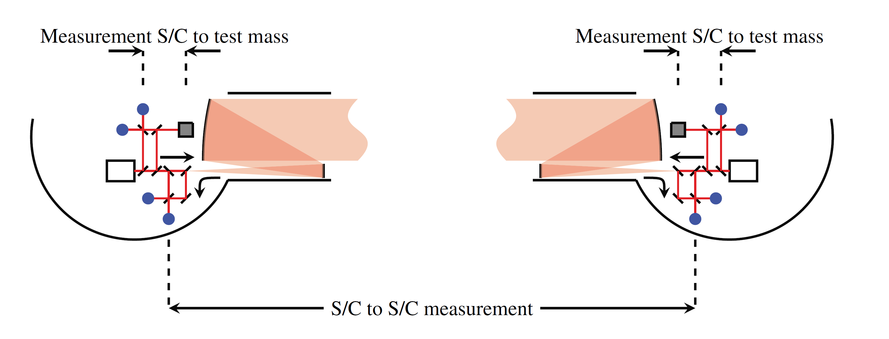
The LISA Satellites
Unequal arm lengths
Split interferometry
Jennrich, 2010
Notes:
Re-word, but the idea of the slide is OK. Maybe motivate LISA more
So this is the WHY? (though it is already more of a how)

Slide 4
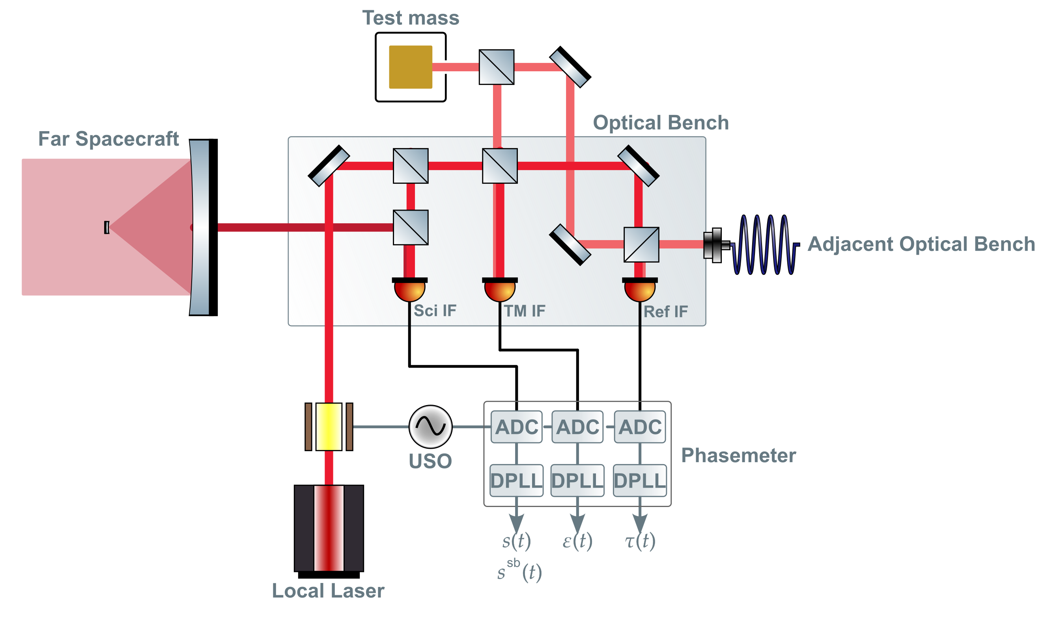
LISA Interferometric Metrology System
Notes:
UGLY
Show what was tested by LISA Pathfinder. Considere removing the PM for the tho
This is the main HOW slide

Slide 5
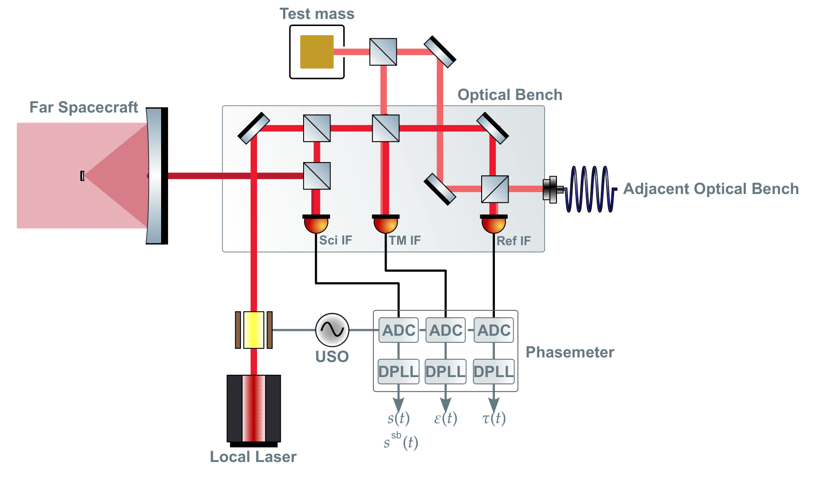
LISA Interferometric Metrology System
Notes:
UGLY
Show what was tested by LISA Pathfinder. Considere removing the PM for the tho
This is the main HOW slide

Slide 6
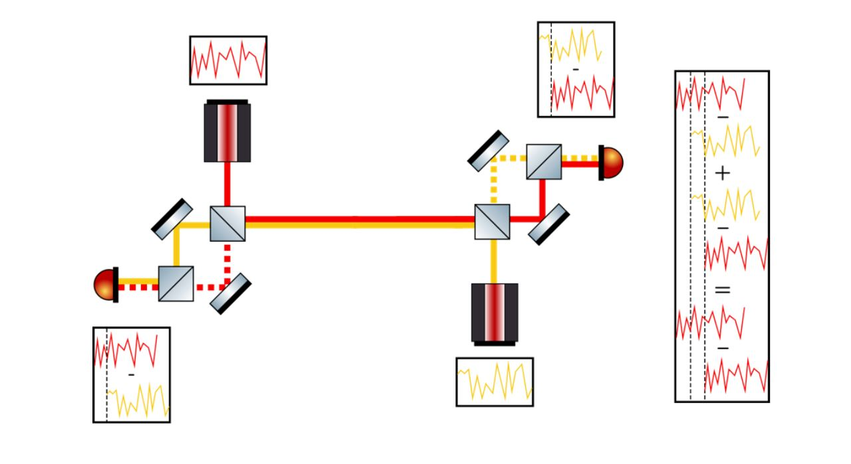
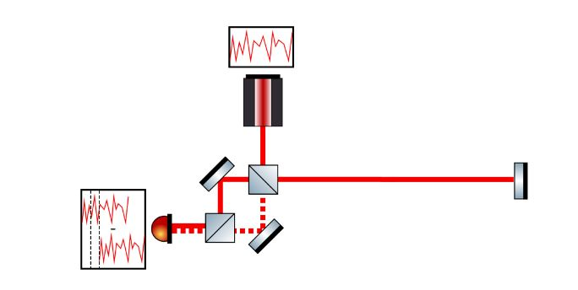
Laser Noise Reduction via TDI
Time Delay Interferometry (TDI) is a cluster of methods to construct virtual equal arms in post-processing.
Transponder signal
Virtual transponder signal
Hartwig, 2021
Notes:
More text. Maybe add the algebra
This is kind of a start for the problem statement

Slide 7
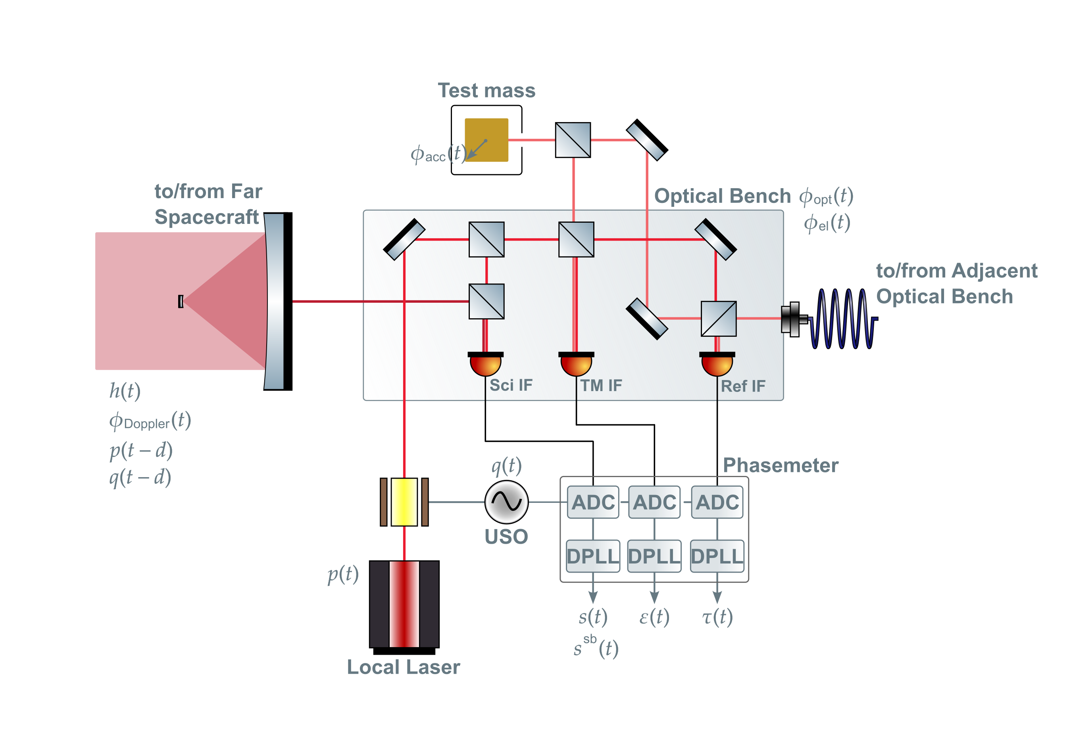
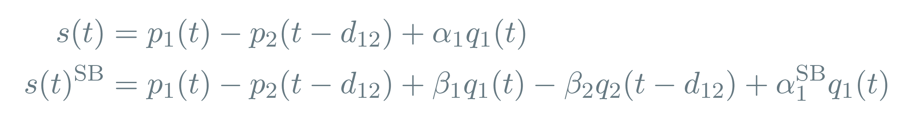
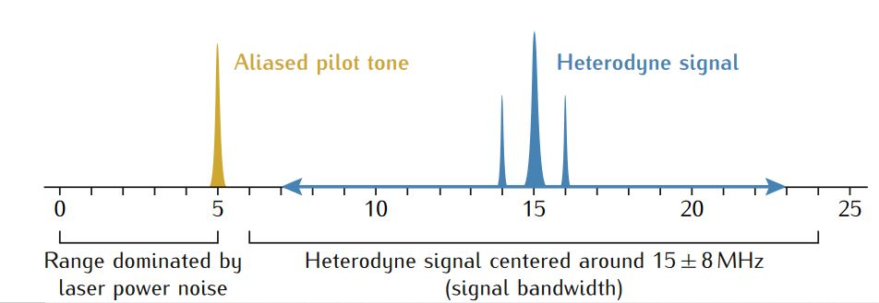
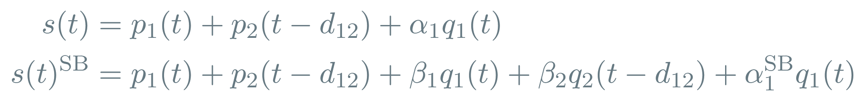
Clock Noise Reduction
After demodulation, considering laser noise and clock jitter:
Lisa metrology system-final report, 2014
Notes:
Follow up problem statement. Bad diagram.

Slide 8
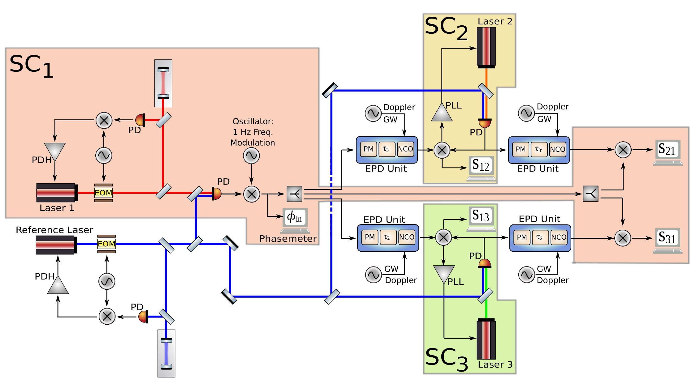
Previous Experiment
Mitryk, 2012: Laser Noise Mitigation through Time Delay Interferometry for Space-based Gravitational Wave Interferometers Using the UF Laser Interferometer
Laser noise, No Clock Jitter, Realistic Delay
Notes:
Don’t show the diagram, show the TDI reduction instead.

Slide 9
MiniLISA
MiniLISA is a hardware testbed that aims to simulate LISA’s signal chain and test whether we can recover a gravitational wave signal from a realistic, noisy system.
To start with, we want to test the combination of second generation TDI and the clock noise removal post-processing methods on experimental data.
MiniLISA could also offer a substitute to modelled noise sources included in current data analysis.

Slide 10
Current Status
A fully electronic implementation of the interferometry system together with a delay and gravitational wave injection has already been developed and is being tested.
Time varying delays
Doppler shifts for both the carrier and sidebands
Gravitational wave injection
Notes:
DIAGRAM!

Slide 11
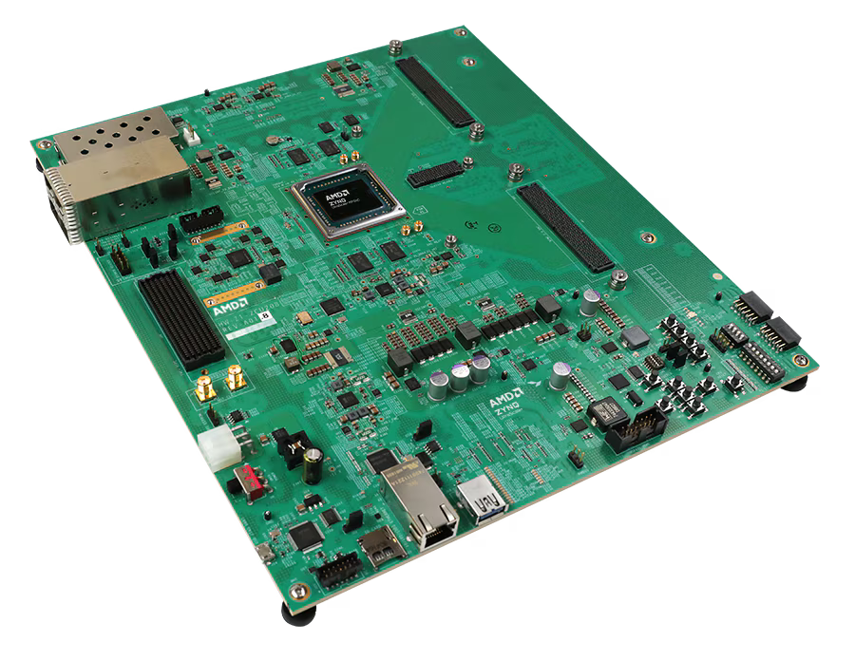
The Delay Line
The center of the experiment is the delay line.
The added varying delays, gravitational wave signals and Doppler shifts are controllable via a Python-based interface.
Signal Processing on the Delay Line
AMD Zynq™ UltraScale+™ RFSoC ZCU208 Evaluation Kit

Slide 12
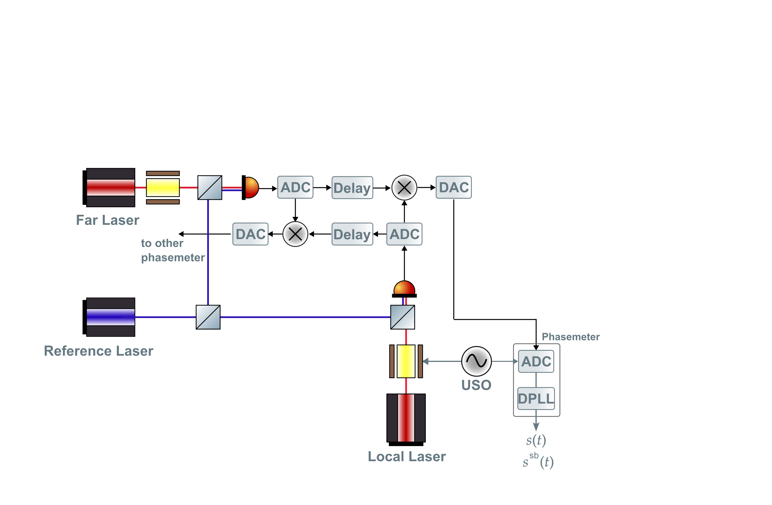
One-arm Phase Measurement
Set up for generating one LISA-like arm link.
Sci IF
~15 MHz
~60 MHz
~10 MHz
Notes:
typo

Slide 13
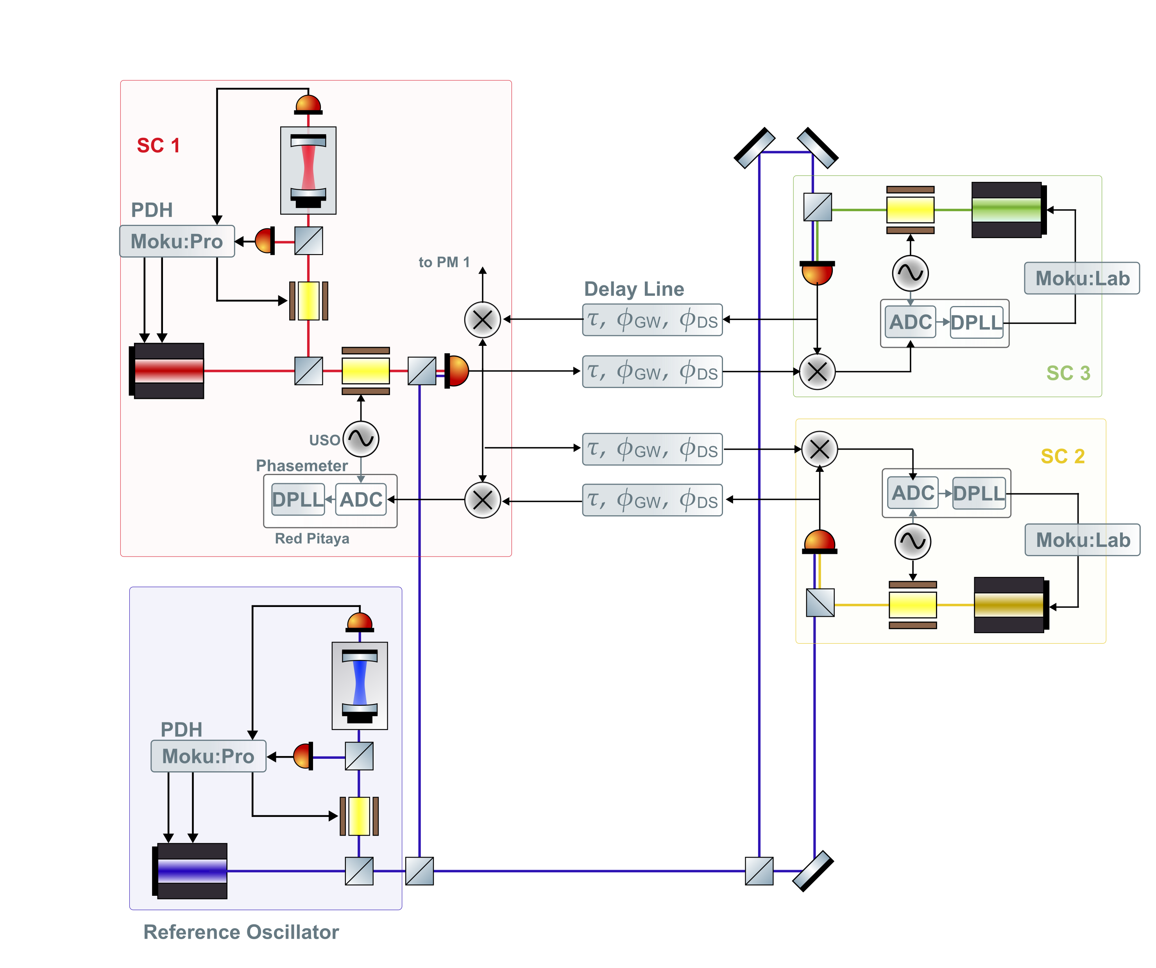
Two-arm Testbed
Notes:
Here have the reference

Slide 14
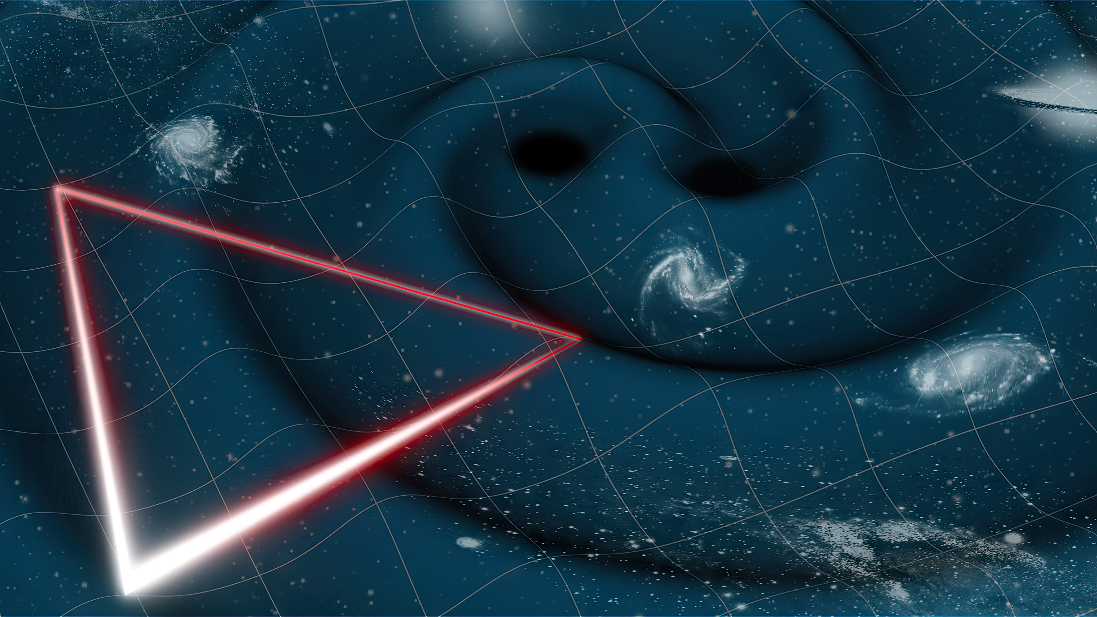
Thank you for listening!

